Slide 2
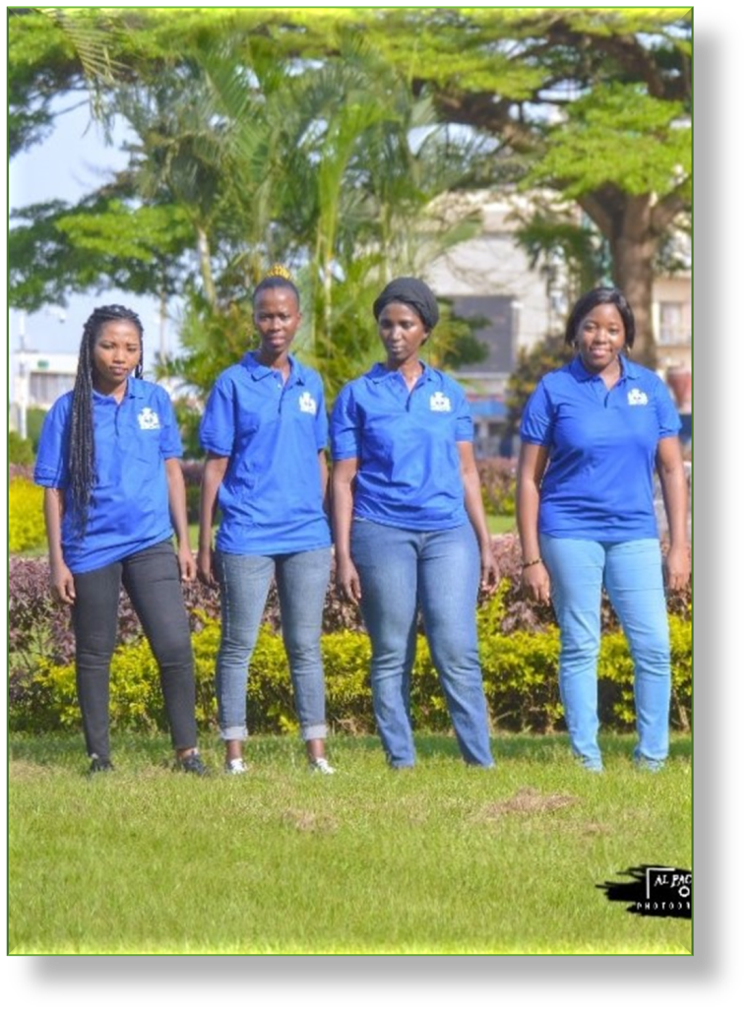
Who's BRIGHT ?
BRIGHT Is a non-profit and non-political association whose aim is to provide all forms of support necessary for the well-being of people in vulnerable situations (refugees, internally displaced persons, migrants, asylum seekers, orphans, abandoned children, the elderly and specific persons).

Slide 3
OUR MISSIONS ARE : -Promote the education of vulnerable people. -Provide vocational training to facilitate the integration of people with special needs. - Promote food security for vulnerable women and children. - Provide psycho-social care for target groups affected by traumatic events. -Ensure the empowerment of target groups. -Promote the implementation of international laws for the protection of target groups.

Slide 4
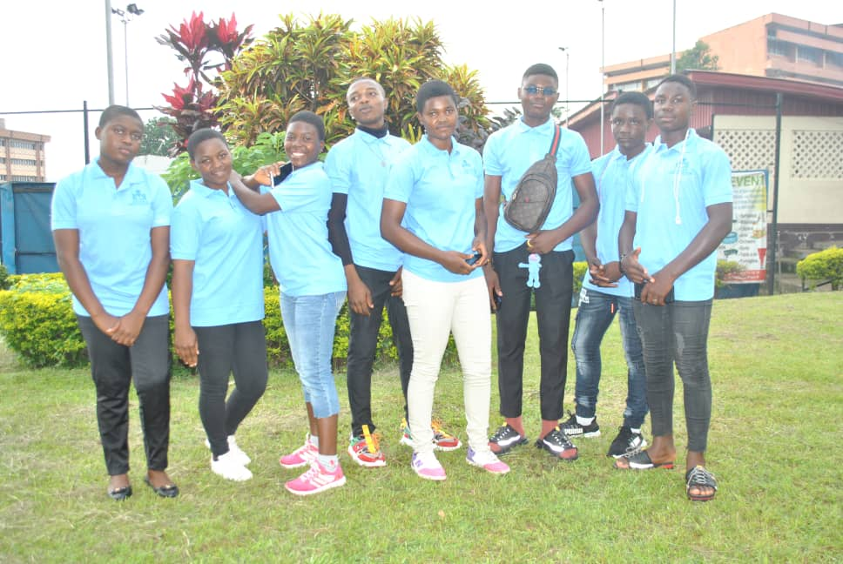

Slide 5
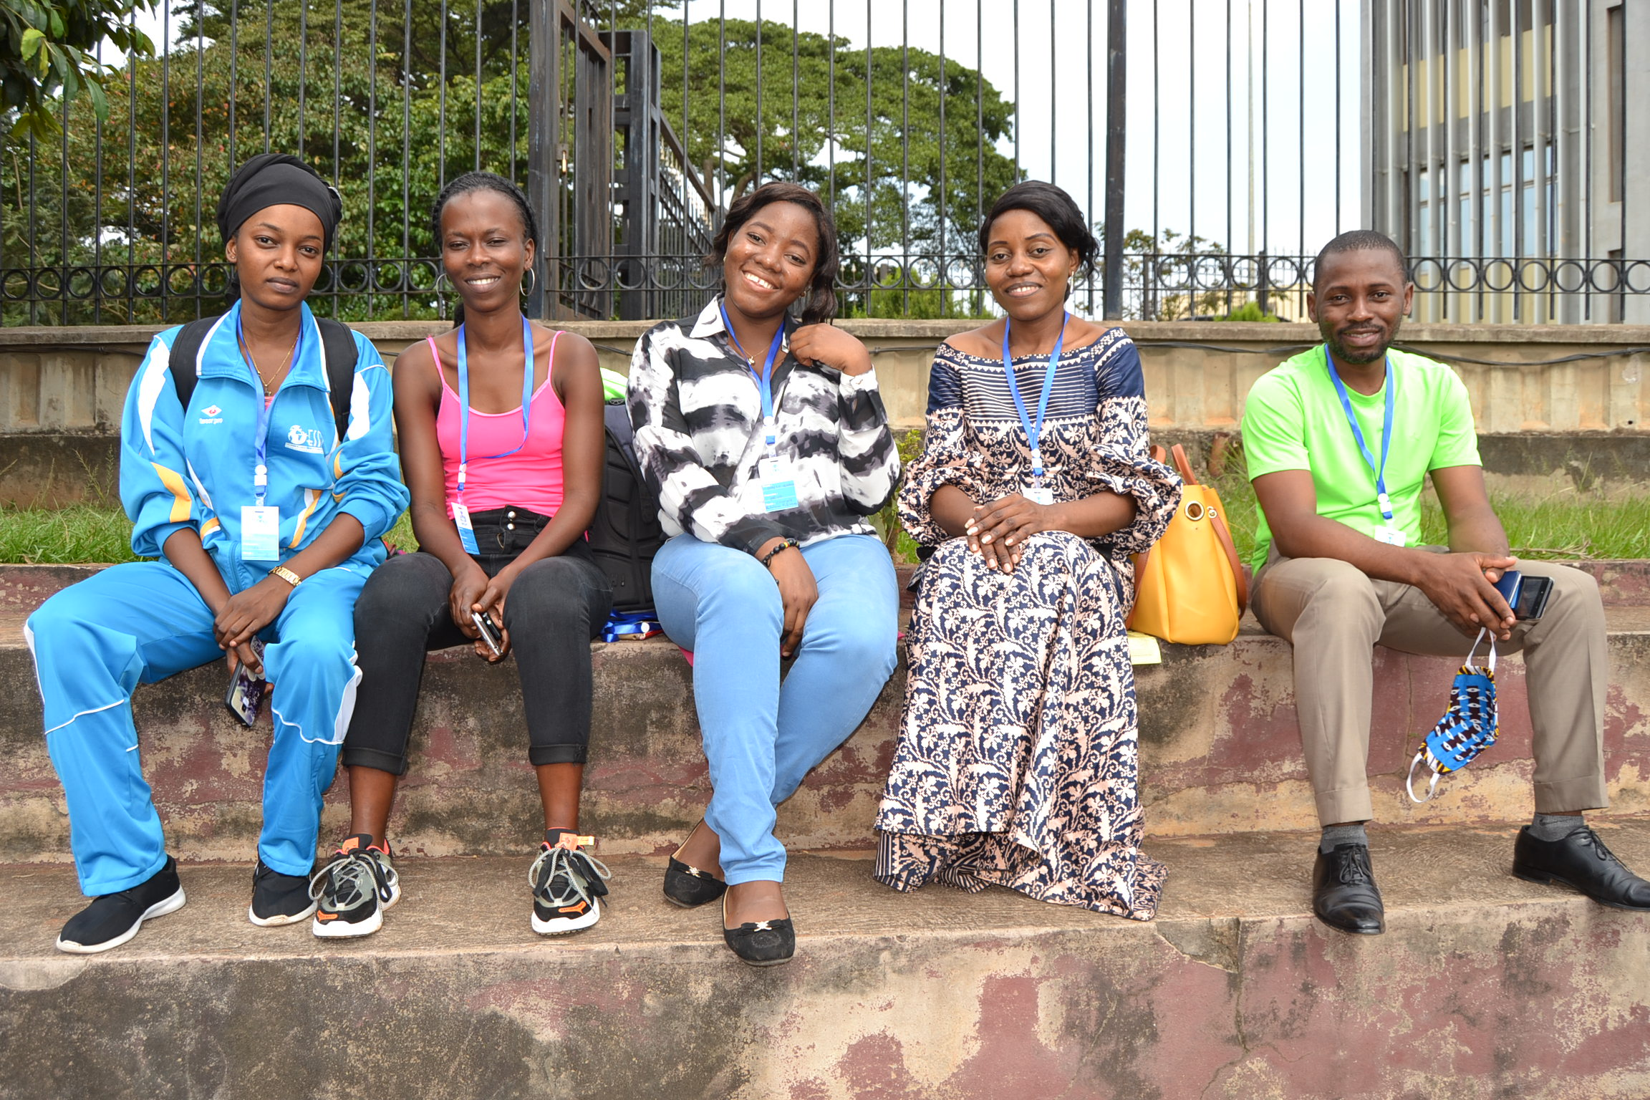
CREATION OF BRIGHT ASSOCIATION
It was created in March 2020, starting with sport and academic activities, and then obtained its declaration of existence in December 2020

Slide 6
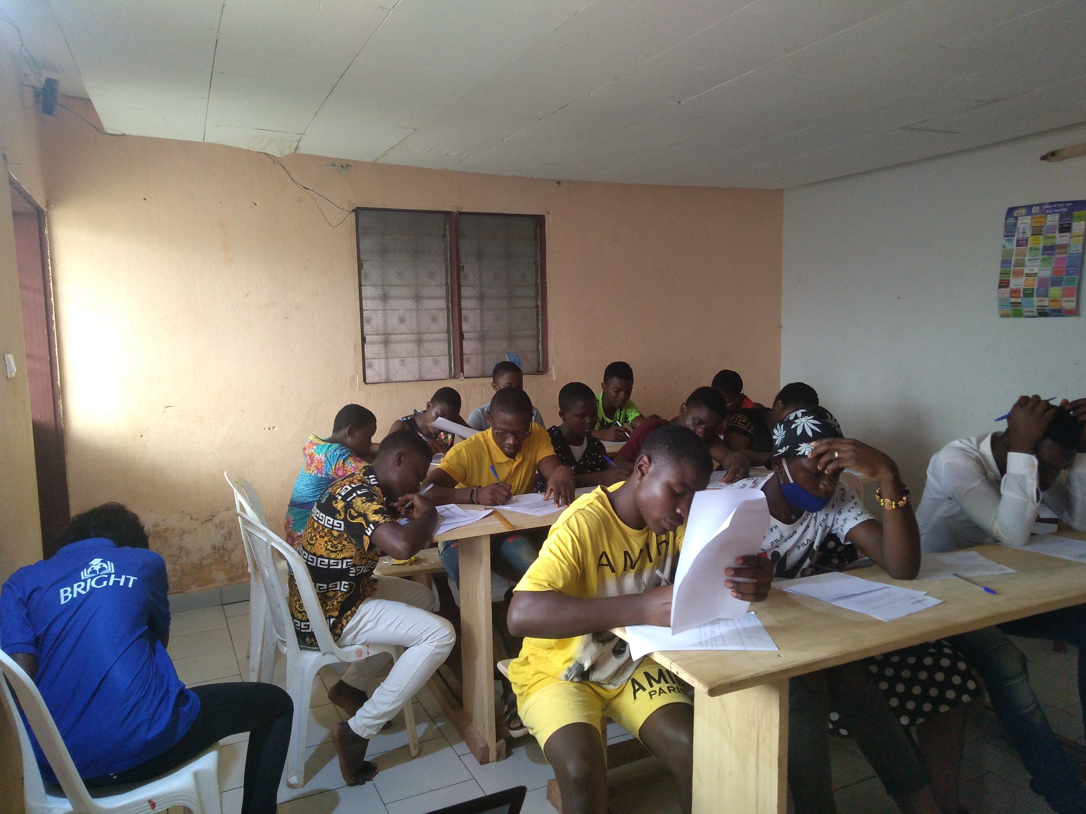
RECRUITMENT
In July 2020, we were able to recruit 20 internally displaced people but only 9 of them have benefited from our sport program, AMALA Peacebuilding courses and photography classes. All this was possible thanks to the support of facilitators recruited during the same month.

Slide 7
Amala Program : PEACE BUILDING IN YOUR COMMUNITY
We have partnered with Amala in August 2020. This course explores ways you can build peace in your communities. The students first learned on issues relating to peace and explored the reasons for conflicts on a local and global level. They also learned on approaches to resolve conflict. Finally, the students were able to plan and conduct an activity to contribute to building peace in their community. They had access to their courses materials via an online platform in their own time. The students had as objectives to master these courses in order to bring up projects on how to build peace in their various communities under the themes:
Barriers to Peace
Mindsets for Peace
Approach to Conflict (Conflict Transformation)

Slide 8
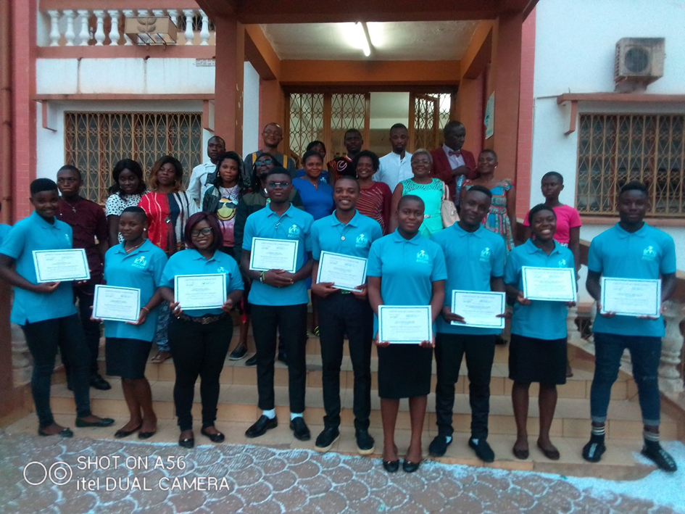
Graduation Ceremony

Slide 9
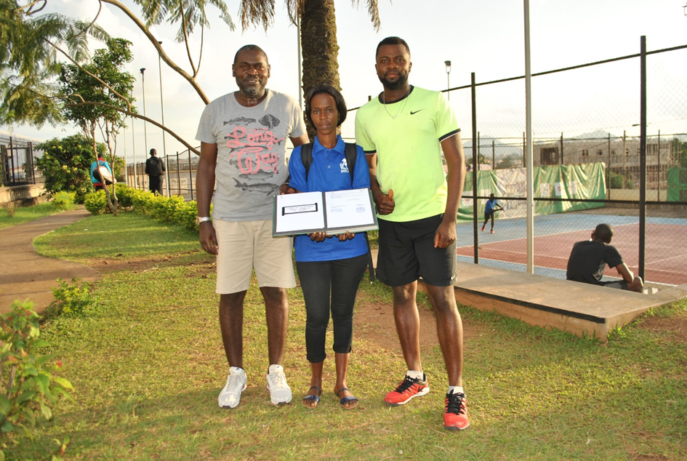
SPORTS ACTIVITIES Nelson Mandela once said: "Sport has the power to change the world. It has the power to unite the world in a way that little else does.“ and that is how we started working with the tennis club of yaounde. We don’t only educate, we also make sure students feel at ease during studies by having fun.

Slide 10
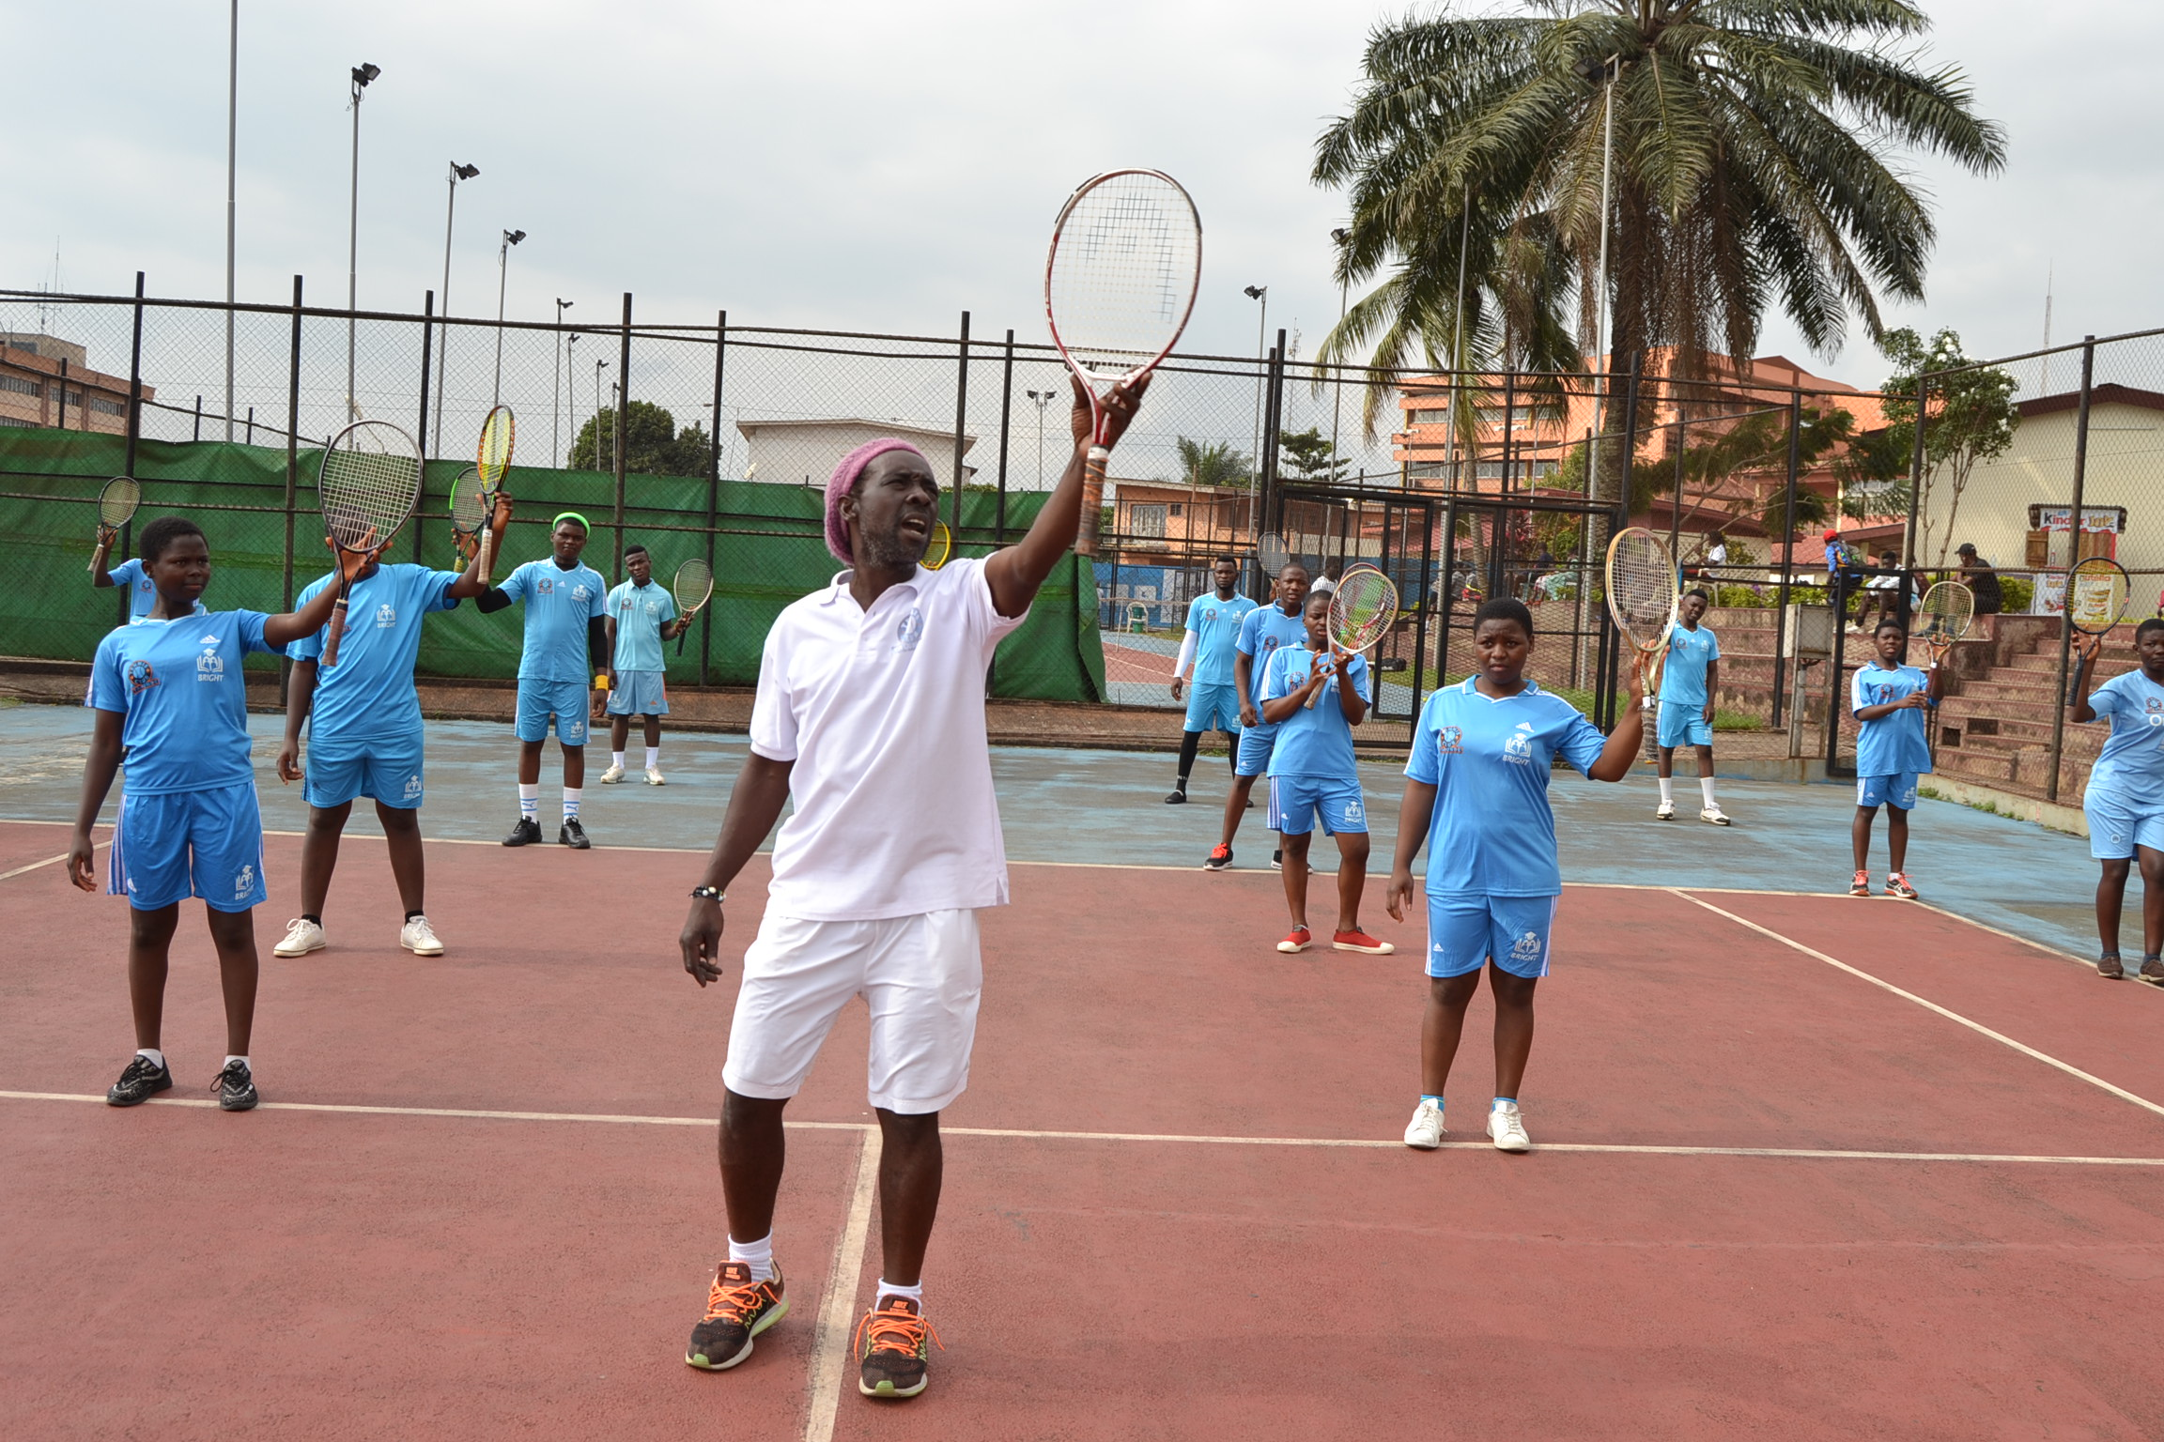
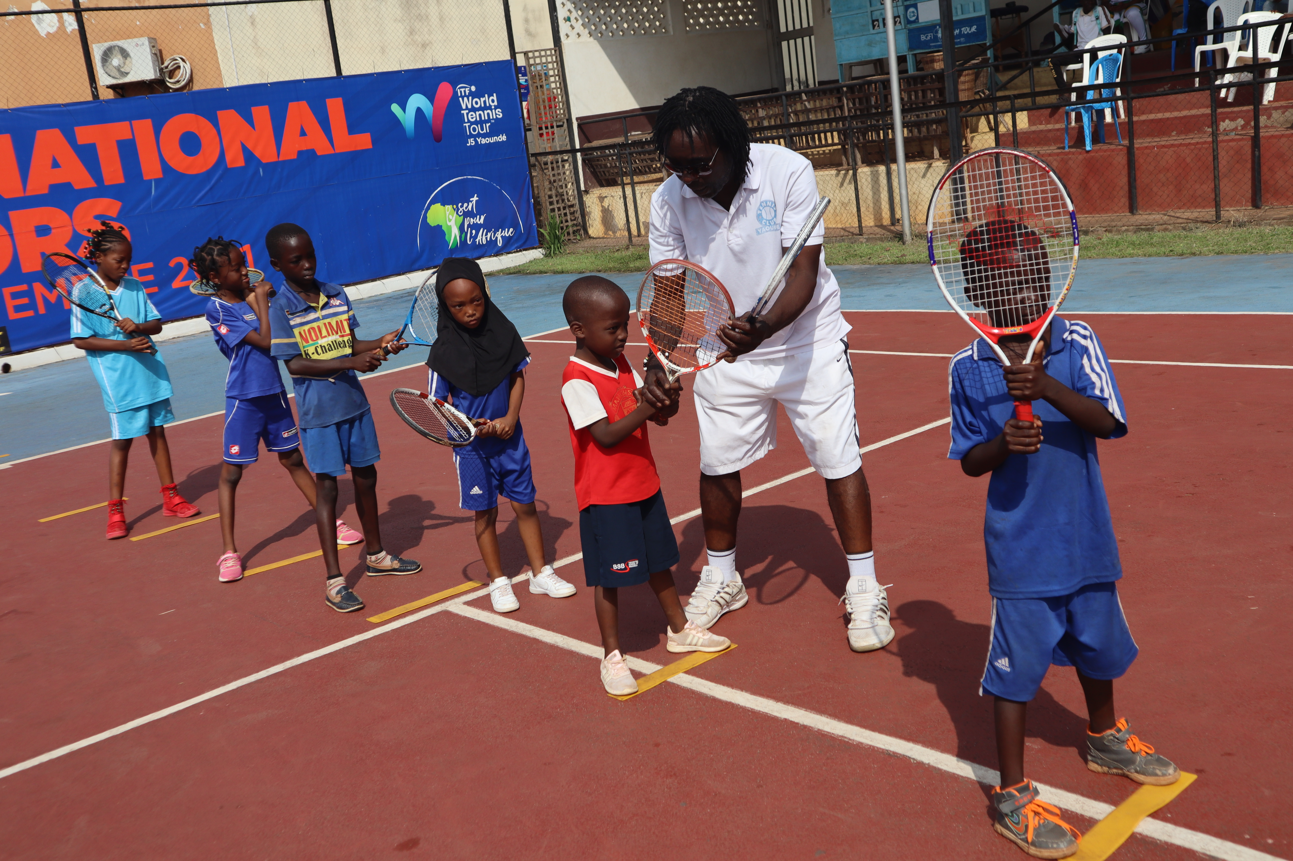
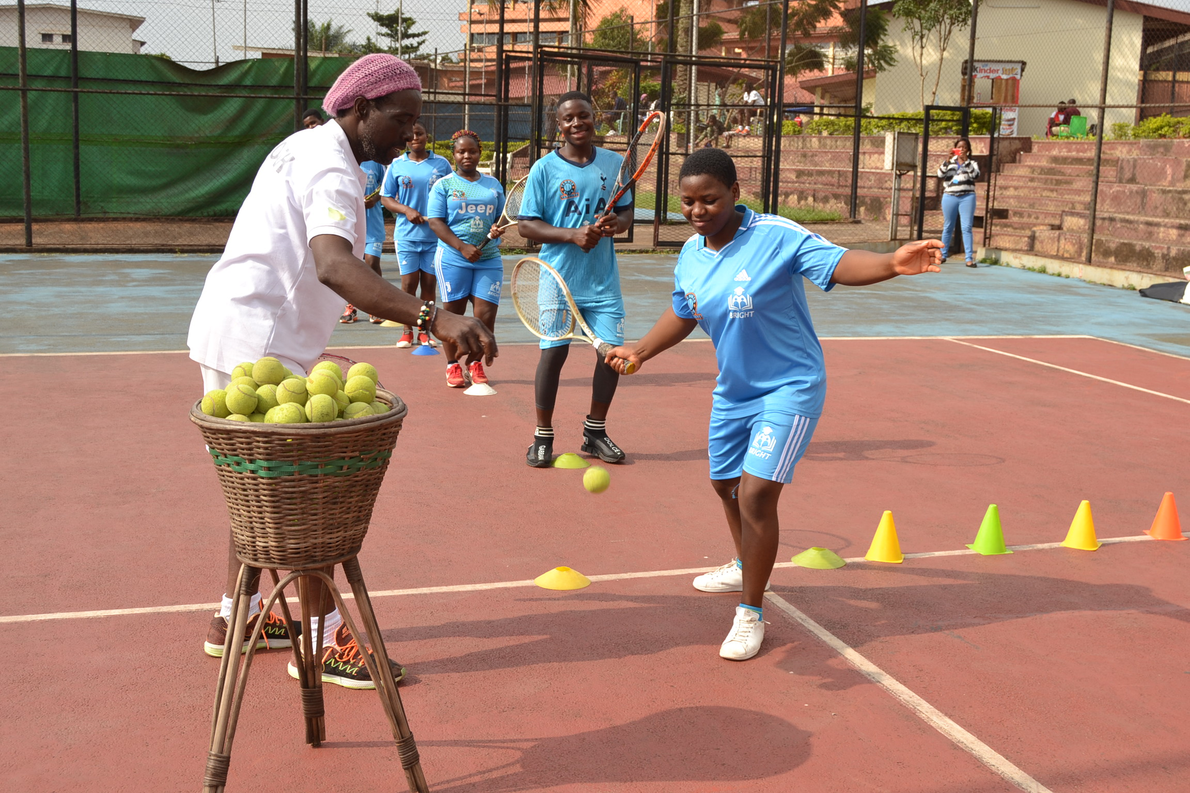

Slide 11
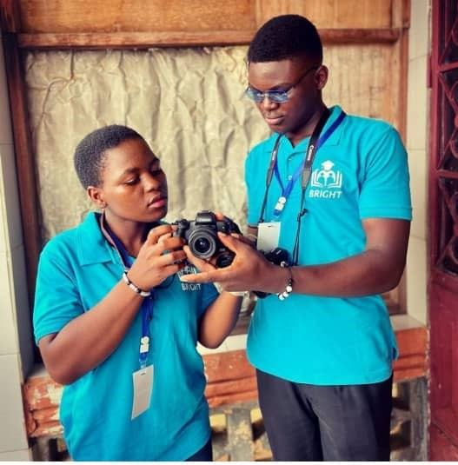
PHOTOGRAPHY CLASSES WITH LENS ON LIFE Since 2021, our students benefit from both online and presential classes on photography. This is another opportunity for these young generation to discover and put in practice their creativity and potential in the art sector as they receive certificates after every program.

Slide 12
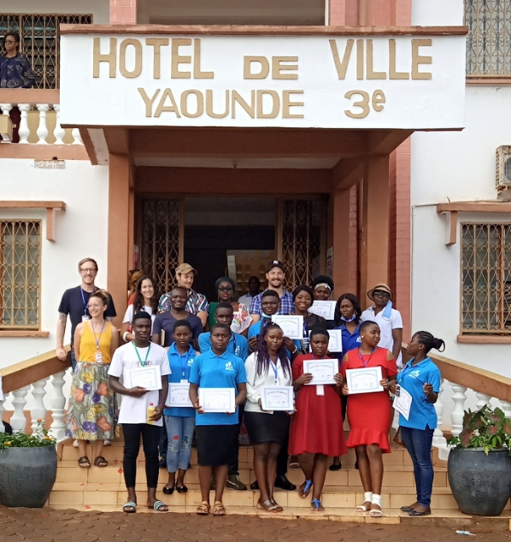
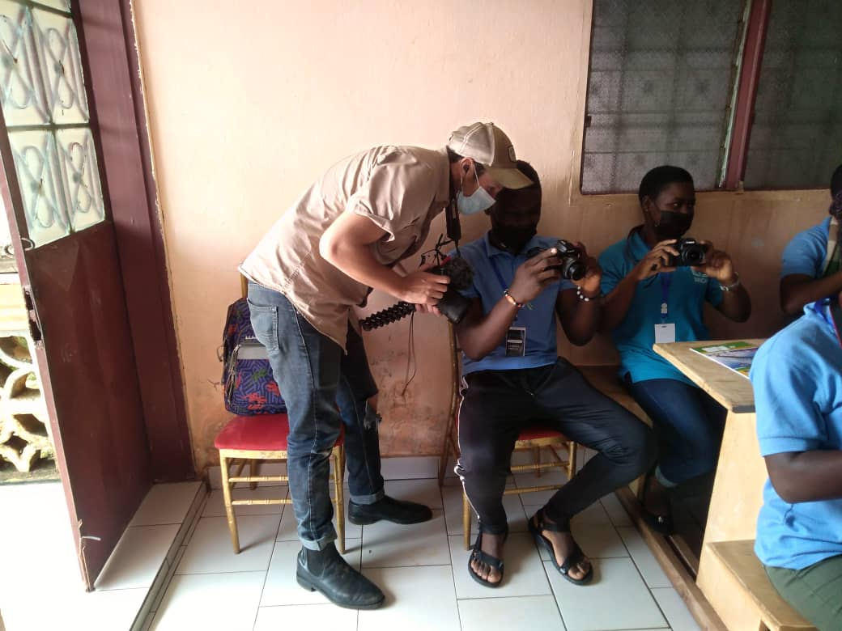
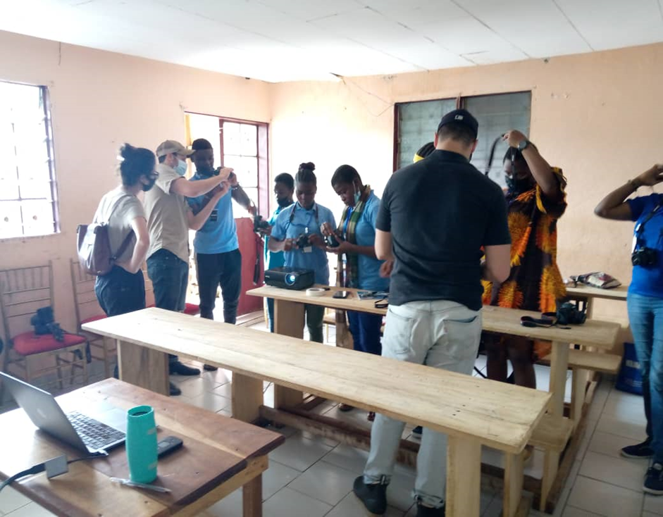

Slide 13
”As Nelson Mandela says, “Education is the most powerful weapon which you can be used to change the world.”
In two and a half years of activities, we have impacted on few lives through our different activities and the support of our partnerships with Amala, Lens On Life and the Tennis Club of Yaounde. The story of BRIGHT's beautiful humanitarian experience with vulnerable people is just beginning.

Slide 14
WELCOME TO CAMEROON AND THANK YOU FOR YOUR ATTENTION !!!

